Slide 1
Lecture – I
B.Sc. III
Subject- Physics [ Seme – V ]
Dr. Devidas Rushiji Bambole
M. Sc. Ph. D.
Department of Physics
Matoshree Vimalabai Deshmukh, Mahavidyalaya, Amravati.

Slide 2
Unit I : Origin of Quantum Mechanics
1.Historical Background: Failure of classical wave theory in explaining Black body radiation and Photoelectric Effect; Compton Effect Qualitative explanation only
2. Assumptions of Planck’s Quantum Theory
3. Wave Particle Duality
4. Matter Waves: De Broglie Hypothesis, Davisson- Germer experiment
5. Concept of Wave Packet, Phase velocity, group velocity and relation between them.
6. Heisenberg’s uncertainty principle: Different forms of uncertainty principle; Thought experiments: single slit diffraction and Gamma ray microscope

Slide 3
Photoelectric effect:
Definition:- when the radiations of high frequency such as ultraviolet light or X-rays is incident on clean metal surface then electrons are emitted from the surface due to absorption of energy from electromagnetic radiation is called as the photoelectric effect and the emitted electrons are called as “photo-electrons”.
As this effect first observed by Heinrich Hertz in 1887, this phenomenon is also known as the Hertz effect

Slide 4
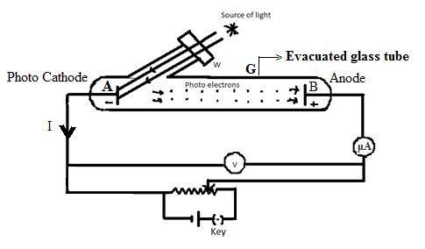
Experimental set up to study the Photoelectric Effect:

Slide 5
This photo-electric current depends upon the following factors.
The frequency of the incident radiation
The intensity of the incident radiation.
P. D. between the electrodes
Nature of the emitting surface.

Slide 6
Emission mechanism (working):
Electrons can absorb energy from photons when they incident on metal surface. The absorption process follows the "all or nothing" principle. All of the energy from one photon must be absorbed and it is used to liberate one electron from atomic binding. If the photon energy is absorbed, some of the energy consumed in making the electron free from the atom, and the remaining amount of energy is given to the electrons as kinetic energy.

Slide 7
Experimental observations of photoelectric emission:
Or characteristics of photoelectric emission:
Effect of frequency on photoelectric effect:-
Definition: For a given metal, there exists a certain minimum frequency of incident radiation below which no photoelectrons are emitted. This frequency is called the threshold frequency.

Slide 8
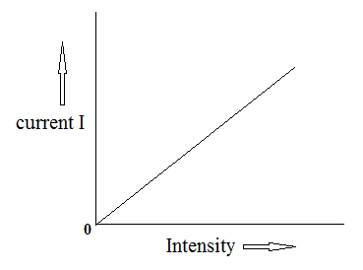
2.Effect of the intensity of the incident light:-
From the graph it is observed that- photoelectric current is proportional to
the intensity of the incident light.

Slide 9
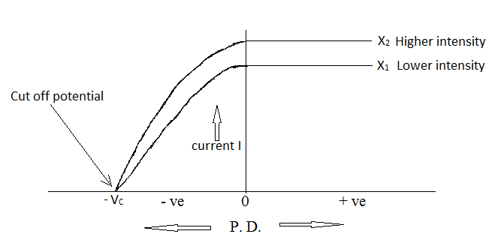

3.Effect of potential drop on photoelectric current:-
The photoelectrons which are emitted with maximum kinetic energy are stopped by the stopping potential. Therefore, work done by the retarding potential on the fastest electron must be equal to
the kinetic energy.
∴ e V_{C} =

Slide 10
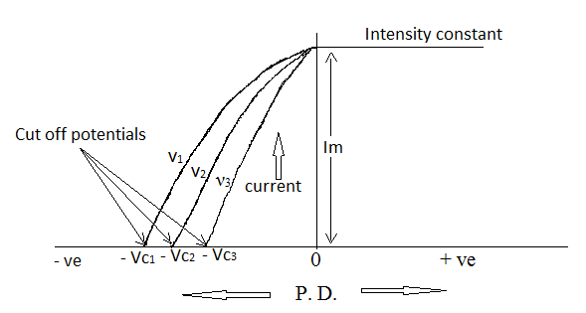
4.Effect of frequency on stopping potential:-
It is observed from the graph that – as the frequency of the incident
light is increased the stopping potential increases. Thus, if the
Frequencies are in the increasing order ν₁ > ν₂ > ν₃ then corresponding
stopping potentials are also in increasing order V_{C1} > V_{C2} > V_{C3}

Slide 11
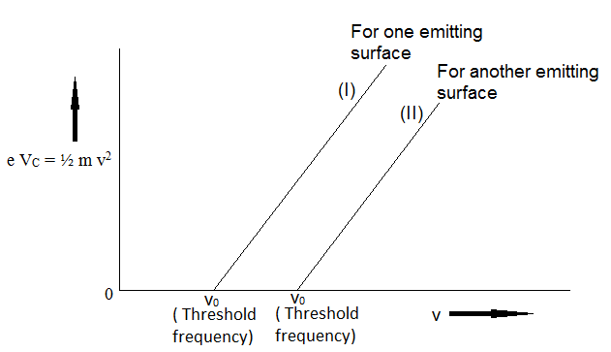

5.Effect of frequency on maximum kinetic energy:-
The magnitudes of stopping potential at different frequencies
are converted into maximum K. E.
i.e. e V_{C} =
The maximum kinetic energy is plotted against the frequencies. The straight lines are obtained as shown in the graph.

Slide 12
Characteristics of photoelectric effect
OR Importance of photoelectric effect:
1. For a given photo-sensitive metal surface, there exists a certain minimum frequency ν₀ of incident radiation below which there is no emission of photoelectrons. This frequency is called the threshold frequency.
The value of ν₀ depends on the material and nature of emitting surface.
2. For a given frequency ν > ν₀, the number of photoelectrons emitted per second from a given surface, under a constant accelerating potential drop is directly proportional to the intensity of incident radiation.
Increase in intensity of incident beam (keeping the frequency fixed) increases the magnitude of the photoelectric current, though the stopping voltage remains the same.

Slide 13
Contin…….
3.The stopping potential for the photoelectrons and hence, the maximum kinetic energy is independent of intensity of radiation.
4. The maximum kinetic energy of photo-electrons emitted from given surface increases linearly with the frequency of incident radiation. A straight line meets the frequency axis at certain frequency ν_{0,} for the given surface.
5. The emission of photoelectrons is an instantaneous process. As soon as radiation of frequency greater than the threshold frequency is incident on given photosensitive surface there is emission of photoelectrons.
The time lag between the incidence of radiation and the emission of a photoelectron is
very small, less than 10⁻⁹ second.

